Slide 1
Module-2-Overview to problem solving
Intelligent agents are supposed to maximize their performance.
Goal formulation, based on the current situation and the agent’s performance measure, is the first step in problem solving.
Problem formulation: is the process of deciding what actions and states to consider, a given goal.

Slide 2
In general, an agent with several immediate options of unknown value can decide what to do by first examining future actions that eventually lead to states of known value.
For eg: If the environment is observable, so the agent always knows the current state.
If the environment is discrete, so at any given state there are only finitely many actions to choose from.
If the environment is known, so the agent knows which states are reached by each action.
If the environment is deterministic, so each action as exactly one outcome.
Under these assumptions, the solution to any problem is a fixed sequence of actions.

Slide 3
Search
The process of looking for a sequence of actions that reaches the goal is called search.
A search algorithm takes a problem as input and returns a solution in the form of an action sequence.
Once a solution is found, the action it recommends can be carried out. This is called execution phase.
Thus we have a simple formulate,search,execute design for the agent.

Slide 4
After formulating a goal and a problem to solve, the agent calls a search procedure to solve it.
It then uses the solution to guide its actions, doing whatever the solution recommends as the next thing to do- typically the first action of the sequence-and then removing the step from the sequence.
Once the solution has been executed, the agent will formulate a new goal.
While the agent is executing the solution sequence it ignores its precepts when choosing an action because it knows in advance what they will be.
An agent that carries out its plans with its eyes closed, so to speak, must be quite certain of what is going on

Slide 5
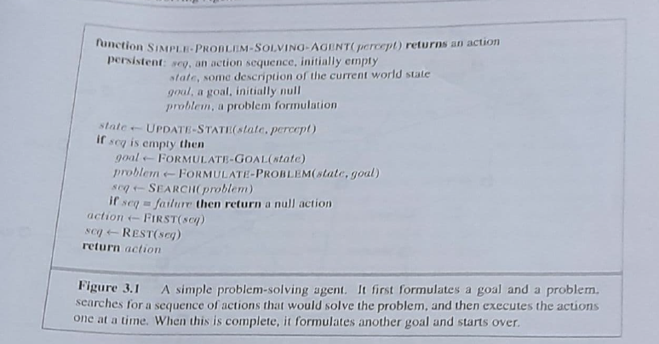

Slide 6
A problem can be defined formally by five components
The initial state that the agent starts in. For eg: the initial state for our agent in Romania might be described as In(Arad).
A description of the possible actions available to the agent. Given a particular state s, ACTIONS(s) returns the set of actions that can be executed in s. Each of these action is applicable in s.
For eg: from the state In(Arad), the applicable actions are
{Go(Sibiu), Go(Timisoara), Go(Zerind)}

Slide 7
A description of what each action does; the formal name for this is the transition model, specified by a function RESULT(s,a), that returns the state that results from doing action a in state s.
Successor: refer to any state reachable from a given state by a single action.
For eg: RESULT(In(Arad), Go(Zerind))= In(Zerind)
Together, the initial state, actions, and transition model implicitly define the state space of the problem- the set of all states reachable from the initial state by any sequence of actions.
The state space forms a directed network or graph in which the nodes are state and the links between nodes are actions.
A path in the state space is a sequence of states connected by a sequence of actions.

Slide 8
The goal test, which determines whether a given state is a goal state. For eg, in chess, the goal is to reach a state called “checkmate” where the opponent’s king is under attack and can’t escape.
A path cost function that assigns a numeric cost to each path (here, the cost path might be its length in kilometers)
The step cost of taking action a in state s to reach state s’ is denoted by c(s,a,s’)
A solution to a problem is an action sequence that leads from the initial state to a goal state.
An optimal solution has the lowest path cost among all solutions.

Slide 9
